Slide 1


FLOORBALL
The World Games
2022 Birmingham, USA
July 7 – 17, 2022

Slide 2
HISTORY OF FLOORBALL
Floorball is a type of floor hockey with five players and a goalkeeper in each team.
Men and women play indoors with 96–115.5 cm-long (37.8–45.5 in) sticks and a 70–72 mm-circumference (2.8–2.8 in) plastic ball with holes.

Slide 3
HISTORY OF FLOORBALL
Matches are played in three twenty-minute periods
Floorball was included in The World Games for the first time in 2017 in Wroclaw, Poland.
Sweden was the first The World Games gold medal winner.

Slide 4
HISTORY OF FLOORBALL
The game was invented in Sweden in the late 1960s.^{[1]}
The basic rules were established in 1979 when the first floorball club in the world, Sala IBK, from Sala, was founded in Sweden.^{[2]}
Official rules for matches were first written down in 1981.^{[3]}

Slide 5
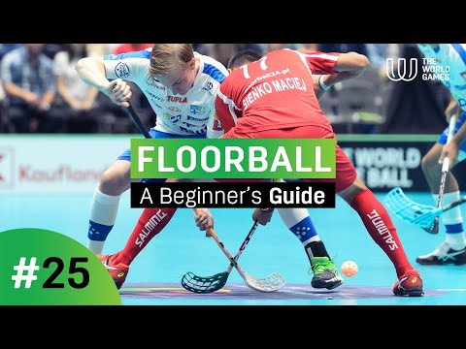
A BEGINNER’S GUIDE TO FLOORBALL

Slide 6
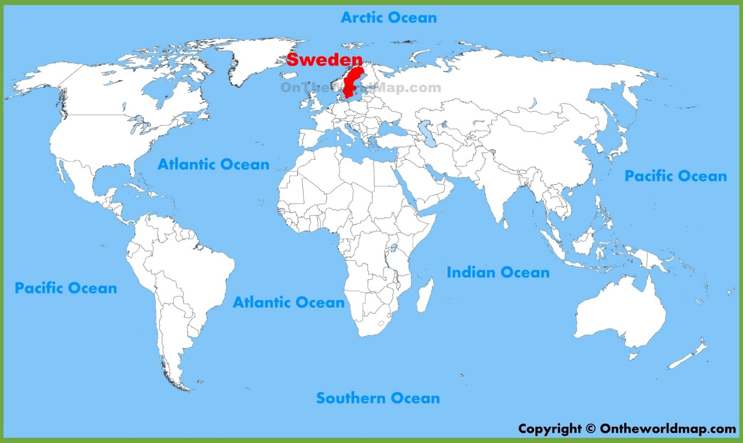
SWEDEN
World map with the country of Sweden marked in red.

Slide 7
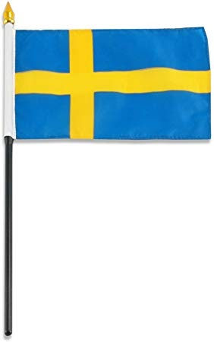
FLAG OF SWEDEN
Sweden’s blue flag with a yellow cross in the center.

Slide 8
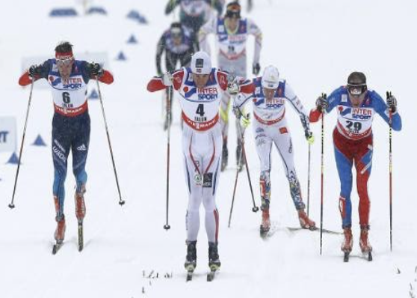
FUN FACT ABOUT SWEDEN
The most famous Swedish sporting event is the Vasaloppet (Vasa race) for cross-country skiers. It is the largest annual cross-country ski race in the world.
Athletes skiing in the snow during a cross-country race.

Slide 9
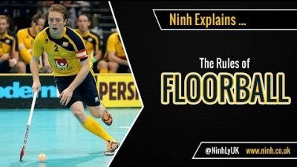
THE RULES OF FLOORBALL

Slide 10
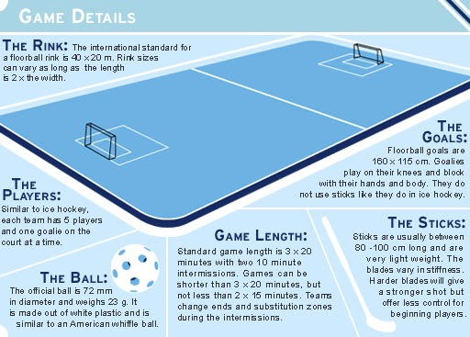
EQUIPMENT

Slide 11
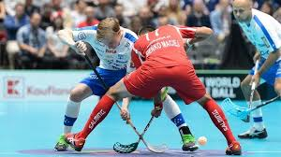
GUIDED QUESTIONS FOR STUDENTS
What sports have you played that are similar to floorball?
Athletes playing floorball using sticks and a ball.

Slide 12

INSTRUCTIONAL GUIDELINES FOR TEACHERS
Word apple shape cloud image title:
Teaching Strategies.

Slide 13
FLOORBALL CLASS RULES: 3 – 12 GRADE
Stick checking and stick lifting are not allowed.
Players may not catch or use their hands to hit the ball.
Players are allowed to go down on one but not both knees to block shots.
Players may not touch the ball with the stick above the knee.
Players are not allowed to hold the opponent's stick.

Slide 14
FLOORBALL CLASS RULES: 3 – 12 GRADE
Players may not put the stick between the legs of the opponent.
Goalies may grab the floorball as long as they have one part of their body in the goal box.
Players may substitute at any point during the game.
Sticks must stay below the waist.

Slide 15
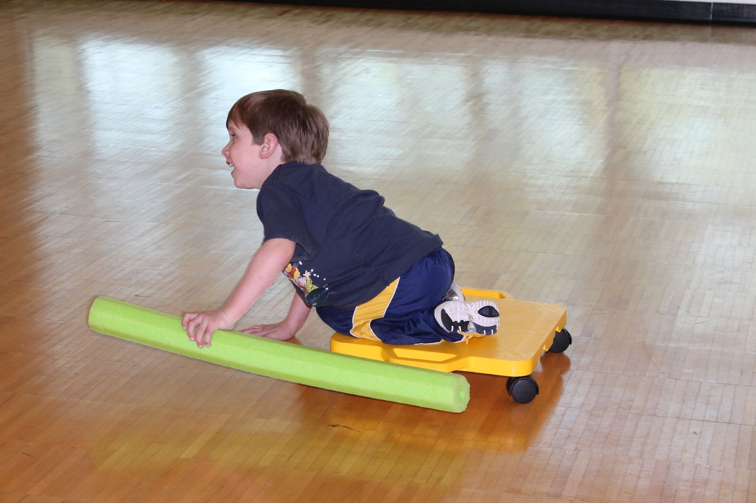
Modified Equipment
MODIFIED EQUIPMENT
Ball: various size “soft” balls
Goals: pop-up goals, cones for goals (if pop-up goals are not available), bigger goals
Area: without obstruction
Sticks: floorball sticks (hockey sticks), pool noodles cut to size of floorball stick
Boy using a pool noodle while moving around in a scooter board.

Slide 16
Modified equipment by grade
MODIFIED EQUIPMENT BY GRADE
K-2
  Pool noodles for sticks
  Beach ball instead of wiffle ball
  Use your hand to hit the beach ball instead of a noodle or stick
  Use bigger goals

Slide 17
Modified Equipment by grade
MODIFIED EQUIPMENT BY GRADE
Grades 3-5
  Pool noodles for sticks
  Beach ball instead of wiffle ball
  Use your hand to hit the beach ball instead of a noodle or stick
  Use bigger goals
Grades 6-8
  Pool noodles for sticks

Slide 18
Strategies for Inclusion
STRATEGIES FOR INCLUSION
Allow mobility devices in the court.
Mark the area with poly-spots, mats, cones, tape or rope.
Use visual start and stop signals and penalties.
When attempting a goal, use visual cues for precision such as things to knock down or a noise-emitting device.

Slide 19
Strategies for Inclusion
STRATEGIES FOR INCLUSION
Use a brightly colored and noise-emitting balls for those with visual impairments.
Use directional clock cues when alerting someone with a visual impairment.
When providing cues that are related to distance within the playing space use cues that are easy to understand, such as “the thrower is 10 steps away from you” instead of using a metric to reference distance.

Slide 20
Strategies for Inclusion
STRATEGIES FOR INCLUSION
Adjust the distance and size of the playing surface and goal nets to better accommodate the students’ abilities.
Students are split into two teams and play scooter floorball.
You can use more than two goal nets for larger classes. Assign a goal net for each team.
Students can attempt to score in any goal net.

Slide 21
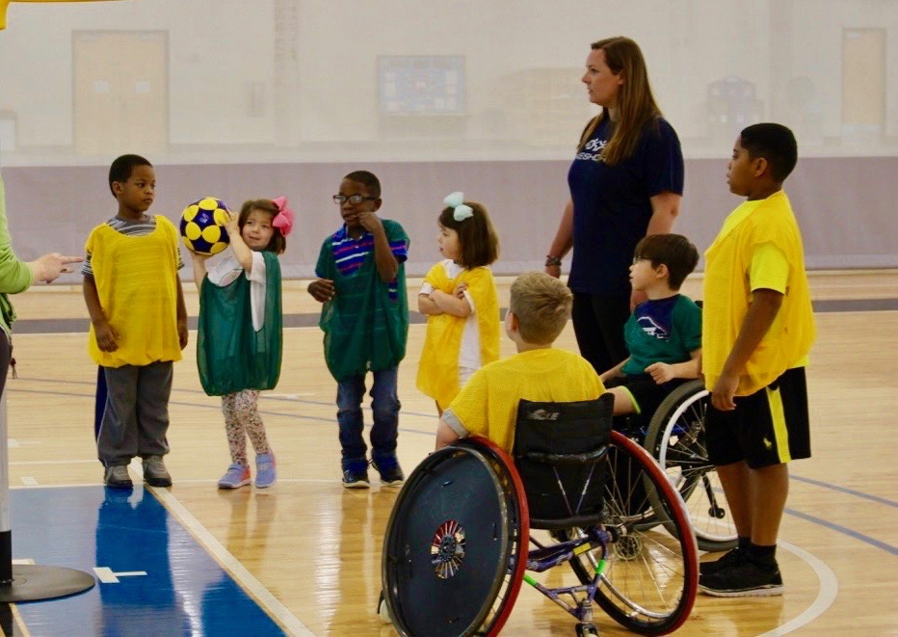
Strategies for Inclusion
STRATEGIES FOR INCLUSION
Instead of a regulation size ball, you can use a bigger ball and floorball sticks made with pool noodles.
Ensure that students are safe by using protective equipment such as protective goggles.
Use a ball with a noise device for students with visual impairments.
Group of kids playing floorball.

Slide 22
For More Information visit
FOR MORE INFORMATION VISIT:
TWG2022.COM

