Slide 1


FLYING
DISC
The World Games
2022 Birmingham, USA
July 7 – 17, 2022

Slide 2
HISTORY OF FLYING DISC
The Ancient Greeks were competing in discus from the 8th century BC. People threw other disc-like objects throughout the centuries. But it wasn’t until the early 20th century, when the love of a food item in the United States, combined with the love of throwing disc-like objects, helped make Frisbee more mainstream.

Slide 3
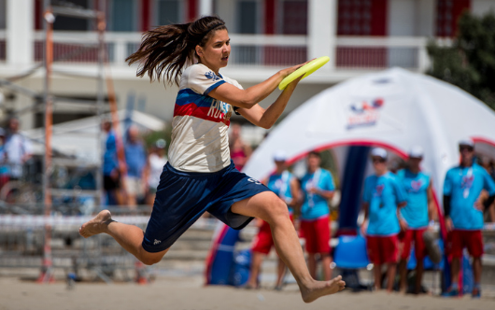
HISTORY OF FLYING DISC
At the end the 19th century, the Frisbie family opened a bakery in Connecticut. The business became successful, and the Frisbie Pie Company expanded into the U.S. states of New York and Rhode Island.
Female athlete from Team Russia catching a disc.

Slide 4


GREECE/UNITED STATES
Map of Greece.
Map of the United States.

Slide 5


FLAGS OF GREECE AND UNITED STATES
Striped white and blue flag of Greece.
Striped red, white, and blue flag
of USA.

Slide 6
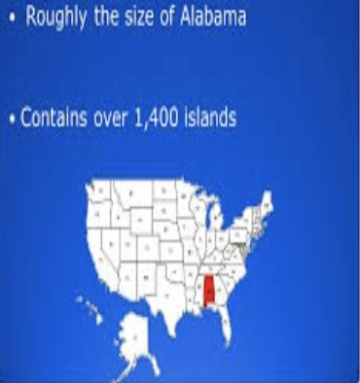
FUN FACT ABOUT GREECE
With an area of 50,949 square miles (131,958 square kilometers), Greece is roughly the size of Alabama. The population of Greece is more than 10 million people. Comparatively, the population of Alabama is around 4.5 million.
Map of USA with state of Alabama colored in red.

Slide 7

FUN FACT ABOUT GREECE
No one in Greece can choose to not vote. Voting is required by law for every citizen who is 18 or older.
Voter inserting his ballot in a ballot box, with the Parthenon in the background.

Slide 8
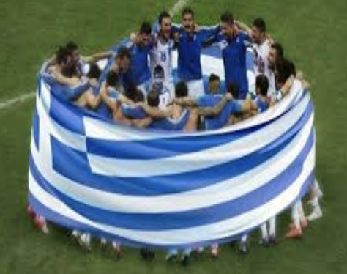
NATIONAL SPORT OF GREECE
Football, or what Americans call soccer, is the national sport of Greece.
Men from Team Greece celebrating, wrapped by the Greece flag.

Slide 9
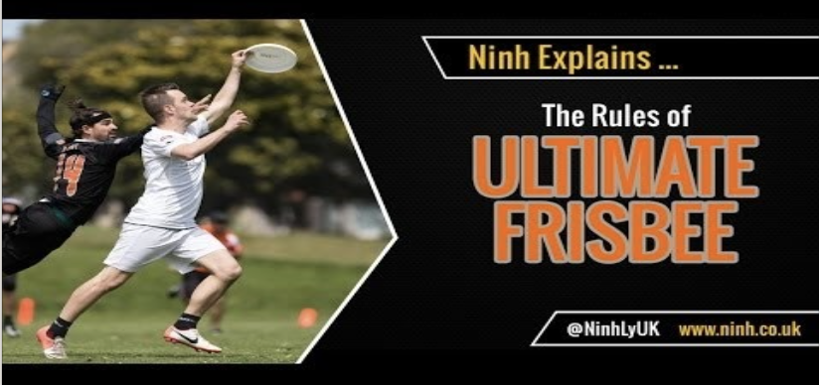
THE RULES OF ULTIMATE FRISBEE

Slide 10
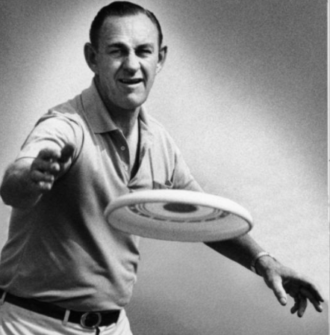
UNITED STATES INVENTOR
In 1948, a Los Angeles building inspector named Walter Frederick Morrison and his partner Warren Franscioni invented a plastic flying disc with better accuracy than a tin pie plate and named it the Pluto Platter.
Walter Frederick Morrison throwing a Pluto Platter.

Slide 11
UNITED STATES HISTORY
The man behind the Frisbee's success, however, was the Southern Californian Edward Headrick, hired in 1964 as Wham-O's general manager and vice president of marketing. Headrick redesigned the Pluto Platter by reworking the mold, mainly to remove the names of the planets, but fortuitously increasing the rim thickness and mass in the process, creating a more controllable disc that could be thrown more accurately.

Slide 12

INTRO TO FLYING DISC
Flying Disc is a limited-contact team sport, meaning that fouls are used to discourage contact between players. It is a unique combination of:
- a flying disc as the object of play (official size: 175 grams)
- gameplay elements from
Soccer (Football), Basketball,
and American Football
Green grass flying disc field with goal.

Slide 13
INTRO TO FLYING DISC
Player-based officiating through "The Spirit of the Game.”
Spirit of the game makes Flying Disc a unique, fascinating, and demanding sport. But you have to know the rules first. Luckily there are only 10 simple rules you need to know before you can start playing. Since Ultimate is self-officiated, it's important for all the players to have a good understanding of the rules.

Slide 14
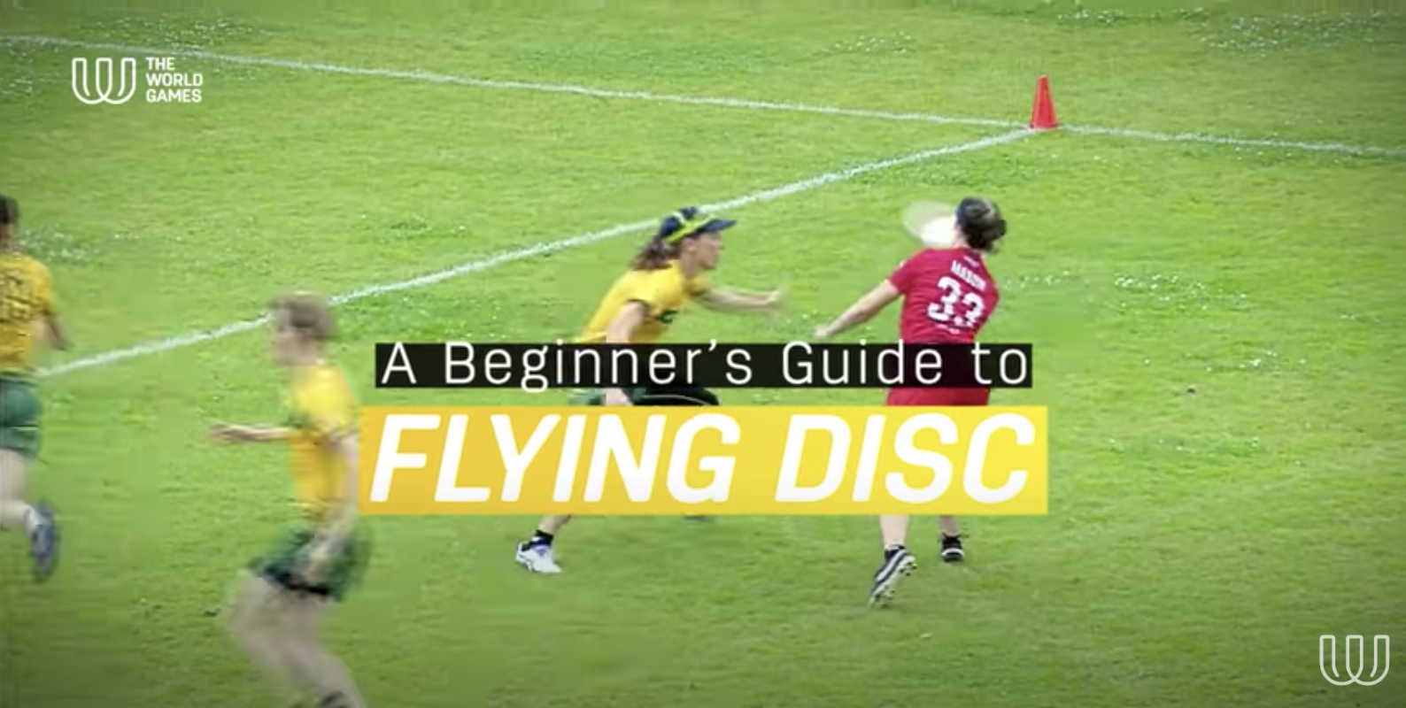
A BEGINNER’S GUIDE TO FLYING DISC

Slide 15
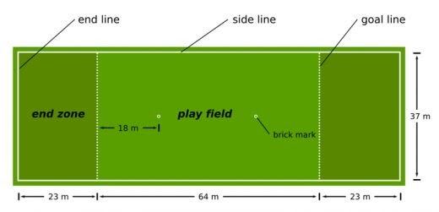
FLYING DISC FIELD
Green rectangle depicting a flying disc field with goal line, side lines and end lines.

Slide 16
RULES
The line is always out of bounds.
The "player with the best perspective" should make the call when play is potentially out of bounds.
Touching or dropping the pull is a turnover.
The marker has to be within 3 meters in order to start the stall count and must loudly state “stalling" just before counting to 10.
Contact should be avoided at all times.

Slide 17

RULES
When catching a disc, the receiver should take only the minimum number of steps required to stop moving. If additional steps are taken, it is a foul.
If the disc is caught by both the offense and defense, the offense retains possession.
Girl in a blue shirt smiling while holding a disc.

Slide 18
SPORTSMANSHIP
The Golden Rule: Treat Others as You Would Want to be Treated; Spirit of the Game.
Give yourself some time and room to breathe after a disputed play, close call, or a hard foul. If you wait just a few seconds you will feel yourself calm down and be able to focus on the facts of the play.

Slide 19
SPORTSMANSHIP
When You Do The Right Thing, People Notice
You may know you've done the right thing, but it can be hard sometimes when there is no obvious praise. However, over time you will see that your opponents and teammates respect you more and more.

Slide 20
SPORTSMANSHIP
Be Generous With Praise
Complimenting the other team’s good play or a teammate’s honesty raise the energy level of everyone in the game.
Impressions Linger
The impressions your teammates and opponents have formed of you will linger for many seasons to come, so this inspires good conduct and the SOTG even more.

Slide 21
SPORTSMANSHIP
Have Fun
Don't focus on any negative energy. Just play hard, act fairly, and have fun!

Slide 22
GUIDED QUESTIONS FOR STUDENTS
What sports have you played that are similar to Flying Disc?

Slide 23

INSTRUCTIONAL GUIDELINES FOR TEACHERS
Word apple shape cloud image title:
Teaching Strategies.

Slide 24

EQUIPMENT
Disc
  Size appropriate
Cones
  10 medium size
Area
  Gymnasium, outside field
Two wheelchair athletes throwing and catching a disc.

Slide 25
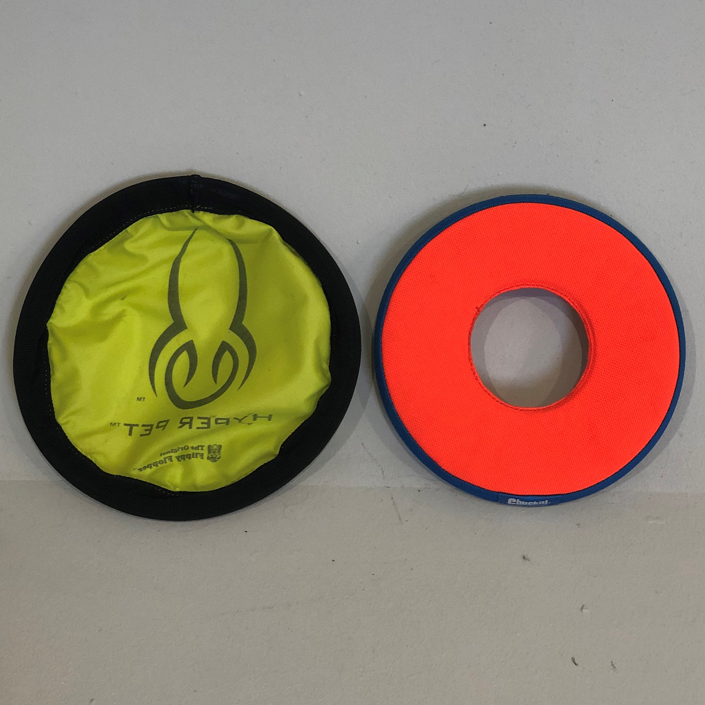
MODIFIED EQUIPMENT
Disc
  Smaller size, foam, Nerf
Cones
  Large, medium, small
Area
  Gymnasium, outside field
Yellow and orange lightweight foam discs.

Slide 26
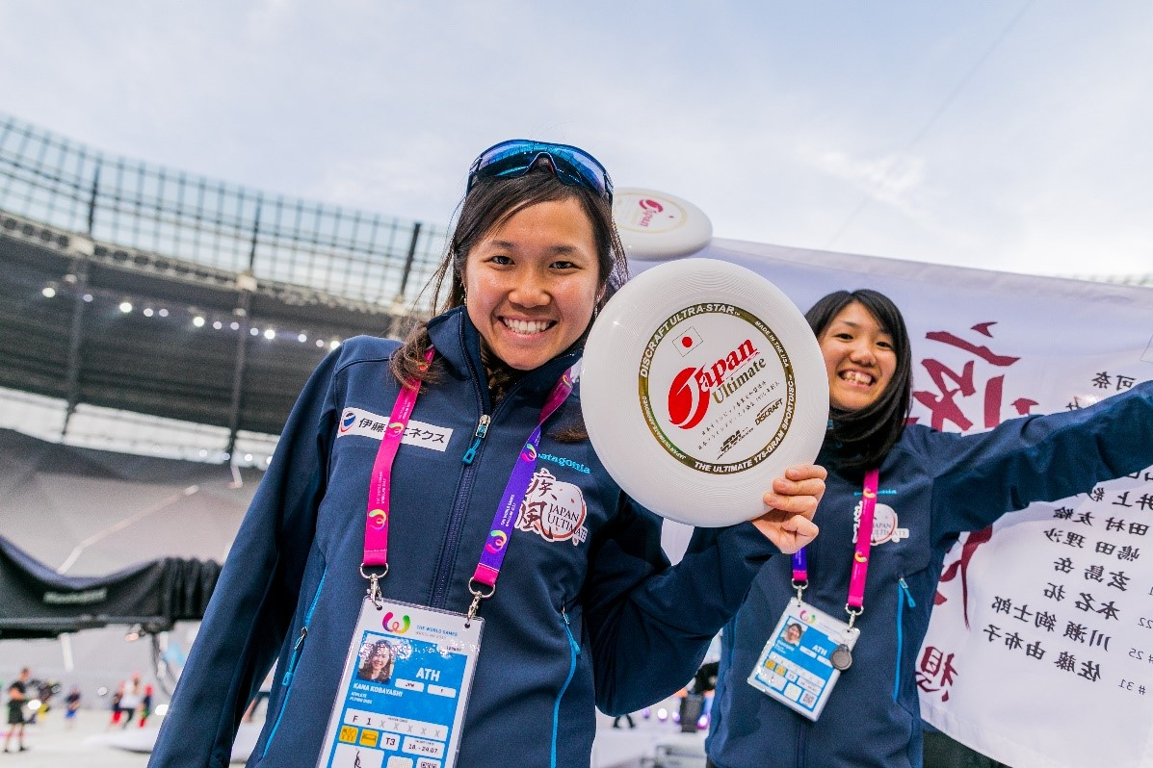
MODIFIED EQUIPMENT TO AGE GROUPS
K-2
  Use a Nerf or foam disc, reduce the length of the field
3-5
  Use a Nerf or foam disc, reduce the length of the field
6-8
  Modify length of the field
Two women athletes from Team Japan holding a white disc.

Slide 27
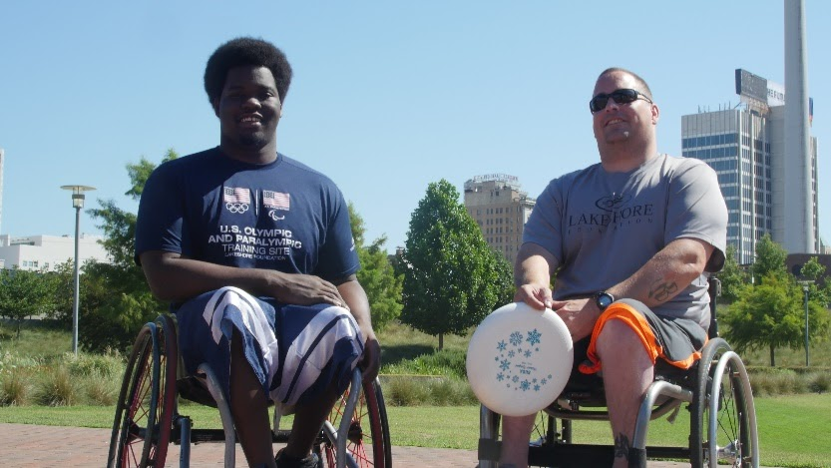
STRATEGIES FOR INCLUSION
Use bigger and brightly colored discs and hoops.
Use bicolor sports markers.
Reduce the perimeter of the playing areas.
Allow the students to score by touching a flying disc instead of catching it.
Two wheelchair users smiling and holding a disc.

Slide 28
STRATEGIES FOR INCLUSION
Allow students to hand the flying disc instead of throwing it on tag games.
Allow the students to tip objects with the disc in their hand instead of throwing the disc towards the objects.
Use a foam disc.

Slide 29
FOR MORE INFORMATION VISIT:
TWG2022.COM

