Slide 1


Introductory Newsletter
INTRODUCTORY NEWSLETTER
The World Games
2022 Birmingham, USA
July 7 – 17, 2022

Slide 2

WELCOME TO THE WORLD GAMES 2022

Slide 3
WHAT ARE THE WORLD GAMES?
First held in 1981, The World Games is a multi-sport event staged every four years by the International World Games Association under the patronage of the International Olympic Committee.
The 11th edition of The World Games will be held in Birmingham, Alabama, USA, July 7-17, 2022.

Slide 4
WHAT ARE THE WORLD GAMES?
It’s the first time the event will be back in the United States of America since it’s first event in 1981.
3,600 athletes from more than 100 countries will take part in 34 sports that comprise The Games.
THIS IS HISTORY IN THE MAKING!
https://twg2022.com/thegames

Slide 5

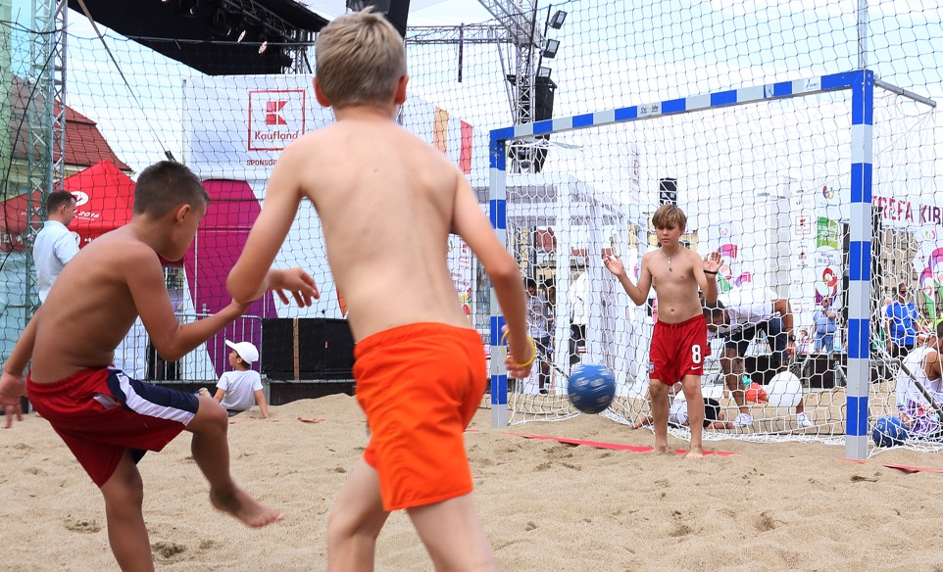
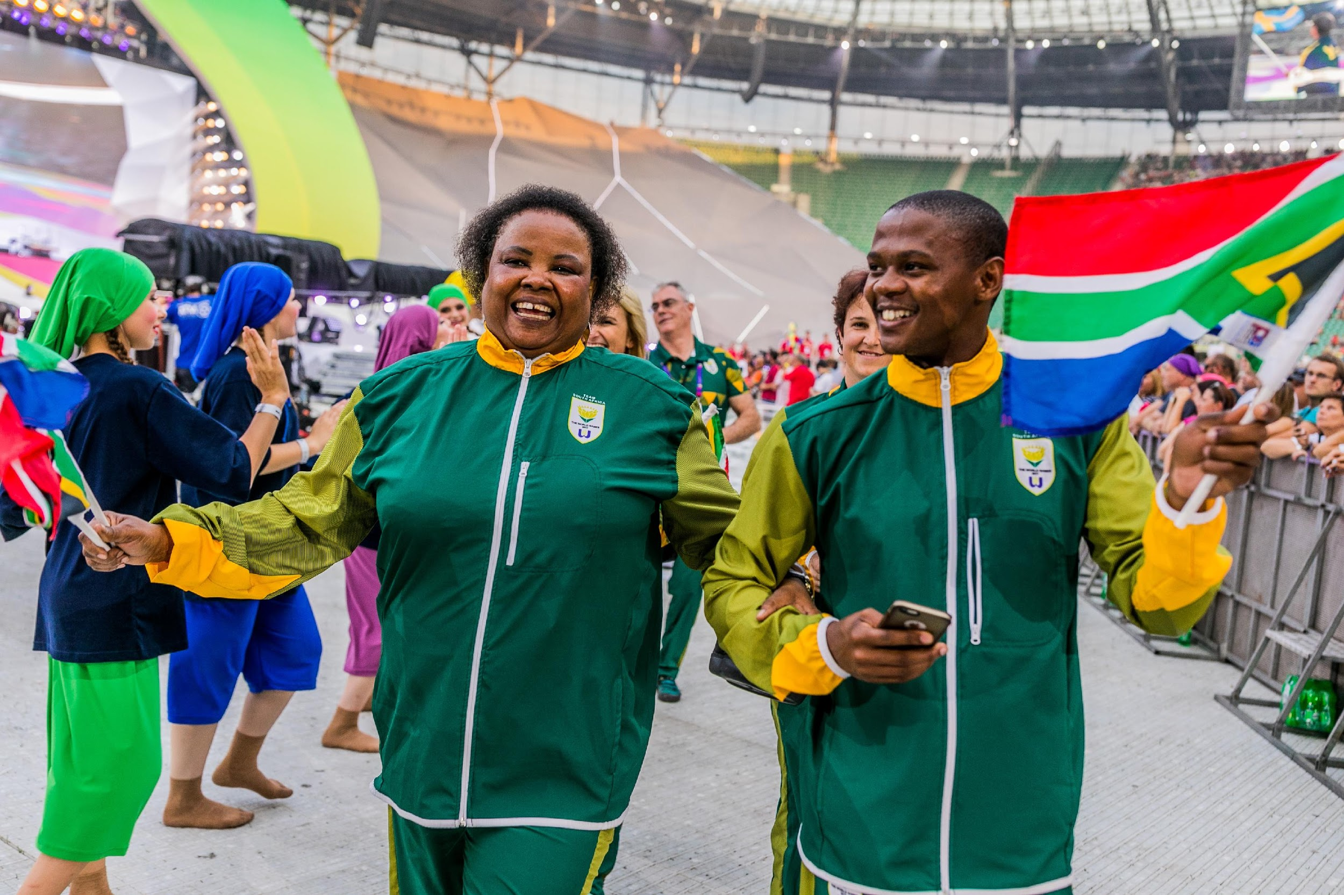
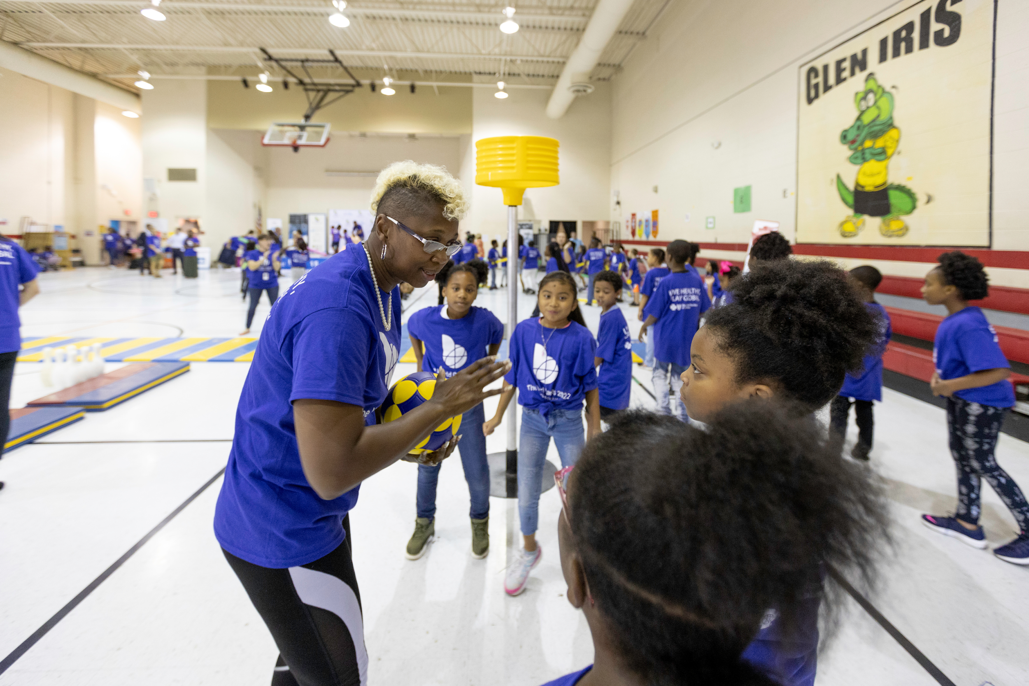
HOW IS TWG2022 RELATED TO THE CURRICULUM?
Sportsmanship
The Spirit of The Games
Physical Education & Fitness Awareness
Global Learning & Connections
Community Engagement
Learning activities meet Alabama State Standards for
many content areas

Slide 6

HOW CAN SCHOOLS BE INVOLVED?
Click these links to view resources for your classroom, school or district.
Educator Toolkit (Primary Resource) www.twg2022.com/education
Classroom Quick Lesson Activities PDF WORD
Greatest Athletes of The World Games ATHLETE OF THE MONTH ATHLETE OF ALL TIME
Daily Announcement - Fact of the Day PDF WORD
Reading Resources AMERICA GREECE SWEDEN THE NETHERLANDS OTHER
Schoolwide International Festival PDF WORD
The World Games Edition
Art - Traveling Mural Project PDF WORD
Civic Activities https://mathewscenter.org/
PTA - Staff vs. Parent Game Night featuring World Games

