Slide 1


Korfball
KORFBALL
The World Games
2022 Birmingham, USA
July 7 – 17, 2022

Slide 2
What is Korfball?
WHAT IS KORFBALL?
Korfball is a ball sport similar to basketball and netball.
A team consists of eight players: four females and four males.
The object of the game is to throw the ball into a bottomless basket mounted on an 11.5 foot pole.
Each team has four players in each half (zone) of the court, and they cannot switch zones during game play.

Slide 3
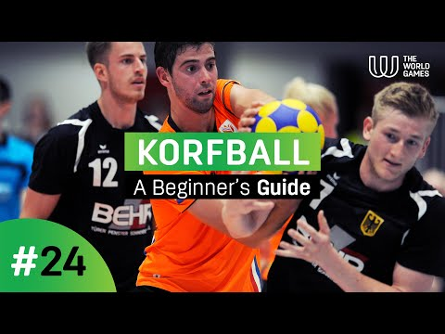
A Beginner’s Guide to Korfball
A BEGINNER’S GUIDE TO KORFBALL

Slide 4
History of Korfball
HISTORY OF KORFBALL
Korfball was originated in Amsterdam, the Netherlands in 1902 by Nico Broekhuysen, a school teacher. Nico was inspired to invent korfball after being exposed to the Swedish game "ringboll."

Slide 5
History of Korfball
HISTORY OF KORFBALL
In ringboll one scores points by throwing the ball through a ring that was attached to a 3 m pole.
Nico replaced the ring from ringboll with a basket (for which the Dutch word is korf or mand), so it was easier to see whether or not a player had scored.

Slide 6
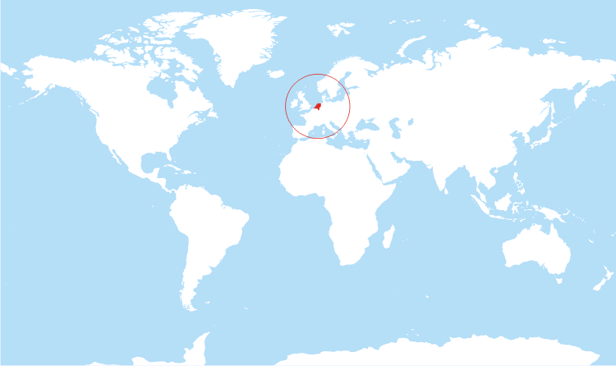
World Map showing the Netherlands.
THE NETHERLANDS
World map with the country of The Netherlands marked in red.

Slide 7
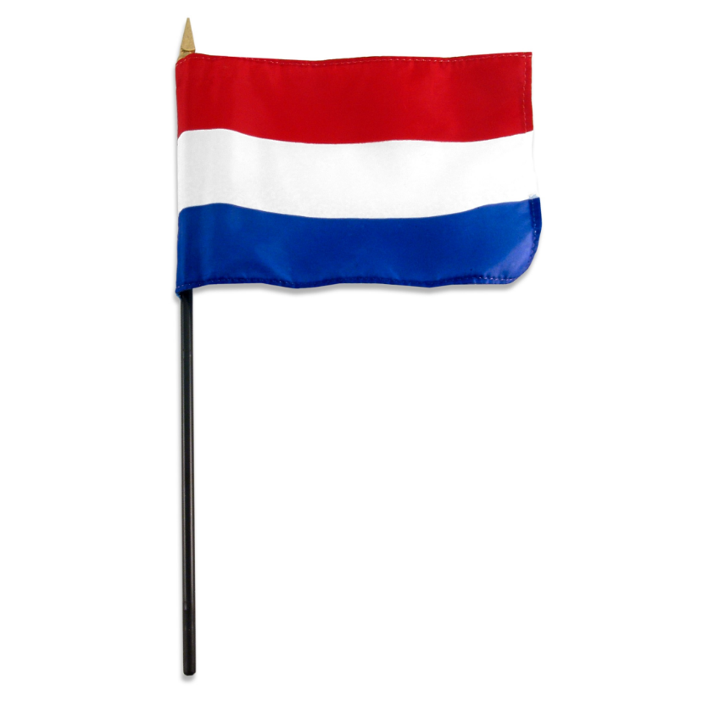
The Flag of the Netherlands
FLAG OF THE NETHERLANDS
The Netherlands’ red, white and striped flag.

Slide 8
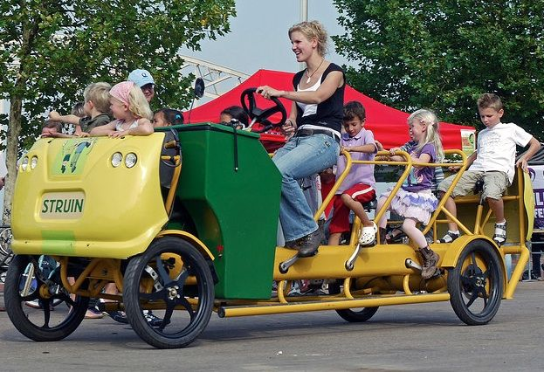
Fun Fact About the Netherlands
FUN FACT ABOUT THE NETHERLANDS
There are 18 million bikes in the country.
Yellow multi-passenger bike with kids as passengers.

Slide 9
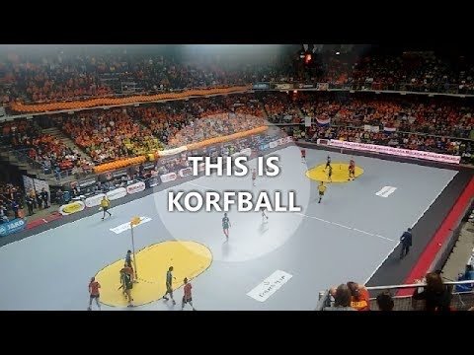
KORBALL PROMOTIONAL VIDEO

Slide 10
GUIDED QUESTIONS FOR STUDENTS
What rules do you see in the game of korfball?
What sports have you played that are similar to korfball?

Slide 11
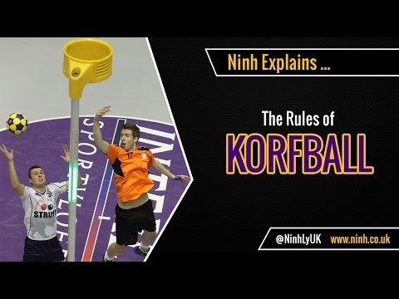
THE RULES OF KORFBALL
NEED LINK

Slide 12
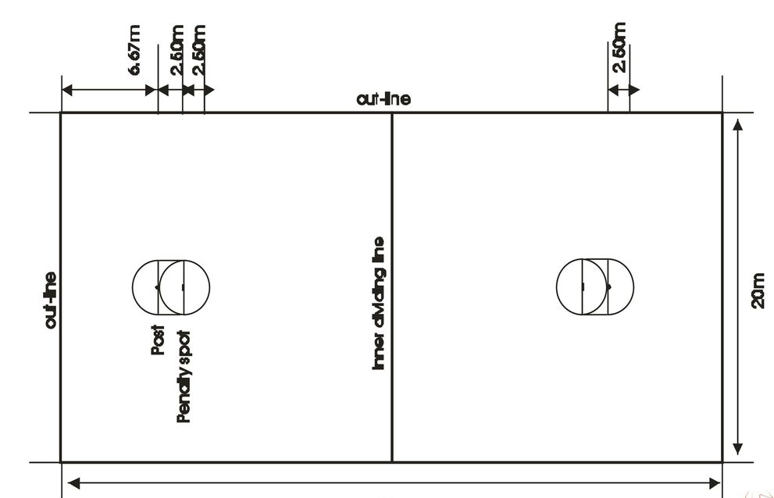
KORFBALL PITCH
White rectangle depicting a korfball pitch/field with out-lines and post/goal boundaries.

Slide 13

INSTRUCTIONAL GUIDELINES FOR TEACHERS
Word apple shape cloud image title:
Teaching Strategies.

Slide 14
KORFBALL CLASS RULES: K-1st GRADE
Start the game
  One team starts with the ball at the top of the court.
Win the game
1 point per basket.
Team with the most points win.
Teams
2 Teams with equal number of players per team.

Slide 15
General rules
Underhand toss the ball to a player on your team.
Try to drop the ball into the bucket.
Try to block the underhand pass.
No walking or running with the ball.
After a team drops the ball into the bucket, the other team gets to start the game.
Variation
Once students understand the concept of passing with no locomotor movement, switch the bucket to a basketball goal at 5’.

Slide 16
KORFBALL CLASS RULES: 3 - 12 GRADE
Start the game
Jump ball like in basketball
Win the game
1 point per basket
Team with the highest number of points win
Teams
2 Teams with 4 players per team
2 boys and 2 girls

Slide 17
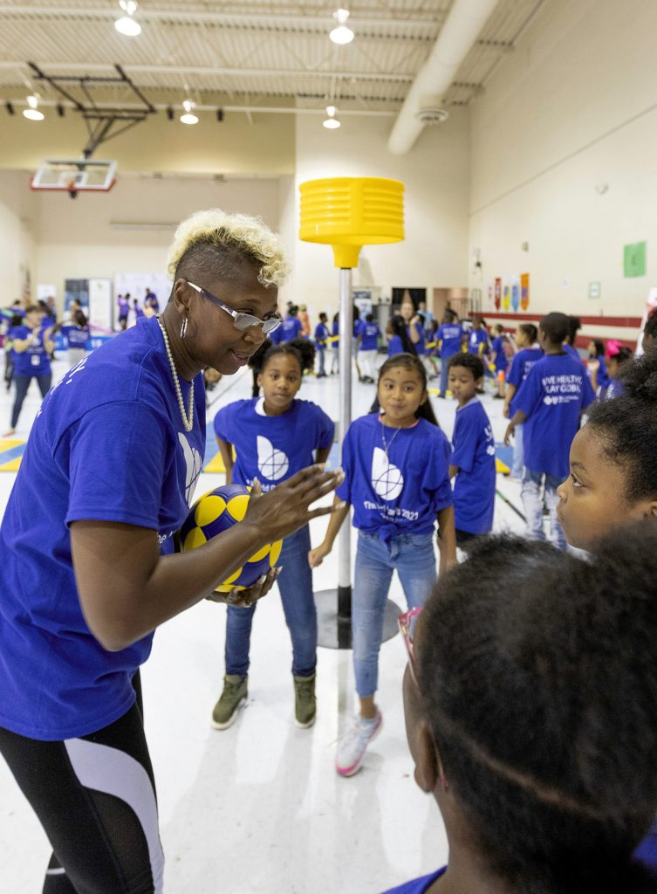
General Rules
Pass the ball using a chest or bounce pass
Can shoot from behind the goal
Block a shot
Rebound a shot
No dribbling (similar to Ultimate Frisbee)
After a made shot, the opposing team goes to the top of the key to start the next series
Teacher giving instructions to kids near a korfball goal.

Slide 18
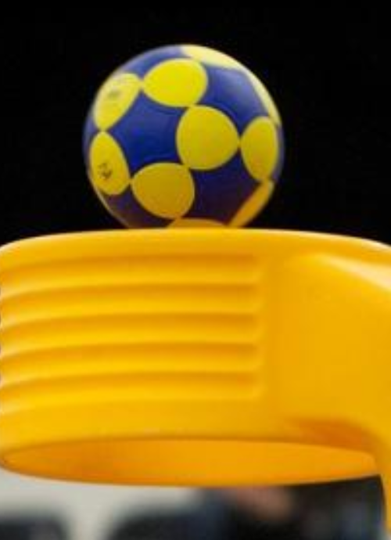
EQUIPMENT
Ball: official korfball
Goals: 2 korfs (goals)
Area: playing area is 22 yds x 44 yds
Blue and yellow ball going through a korfball goal.

Slide 19
MODIFIED EQUIPMENT
Ball: soccer ball, kickball, basketball, gator ball, or volleyball
Goals: round laundry basket with an opened bottom; attach laundry basket to a portable standard
Area: free of obstruction

Slide 20
MODIFIED EQUIPMENT FOR GRADES
K-2 Exception would be to lower goals to 5’
    - Size 3 soccer ball
3-5 Exception would be to lower goals to 6’
  - Size 4 soccer ball
6-8 Exception would be to lower goals to 9’

Slide 21
STRATEGIES FOR INCLUSION
Allow mobility devices in the pitch.
Mark the area with the participants’ poly-spots, mats, cones or tape or rope.
Use visual start and stop signals and penalties.
Replace balls with objects that are easier to grasp such as bean bags.

Slide 22
STRATEGIES FOR INCLUSION
Use a bigger and lower korf.
When throwing to the korf, add visual cues for precision such as things to knock down or a noise-emitting device.
Use a brightly colored and noise-emitting balls for those with visual impairments.

Slide 23
STRATEGIES FOR INCLUSION
Use a bounce pass when passing to someone with limited dexterity or visual impairment.
Touching the ball in the air or after a bounce can be considered a successful catch.

Slide 24
FOR MORE INFORMATION VISIT:
TWG2022.COM

