Slide 1
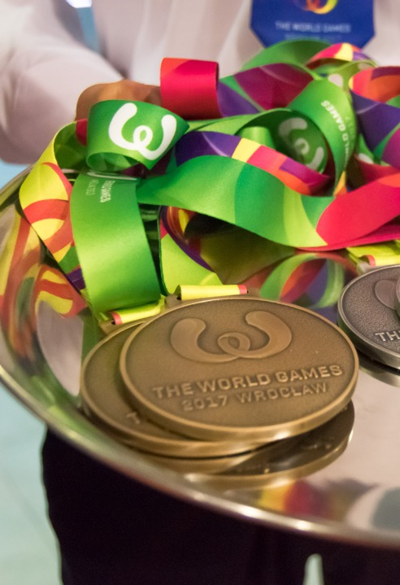

The World Games
Birmingham, USA
July 7 – 17, 2022

Slide 2
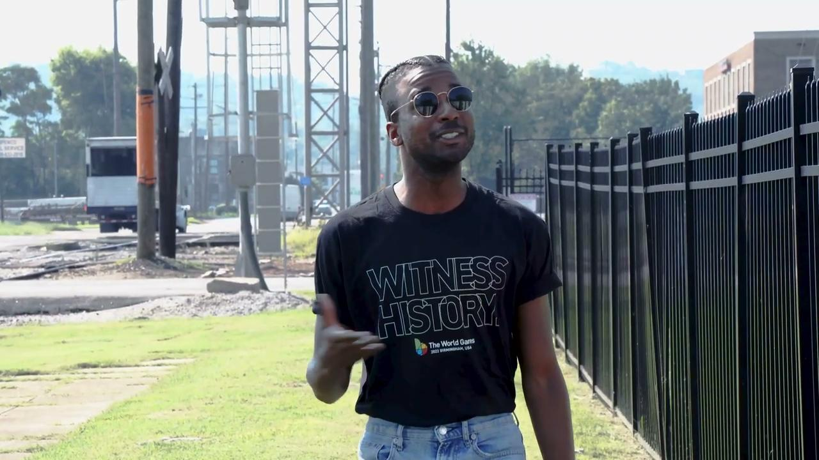

Slide 3
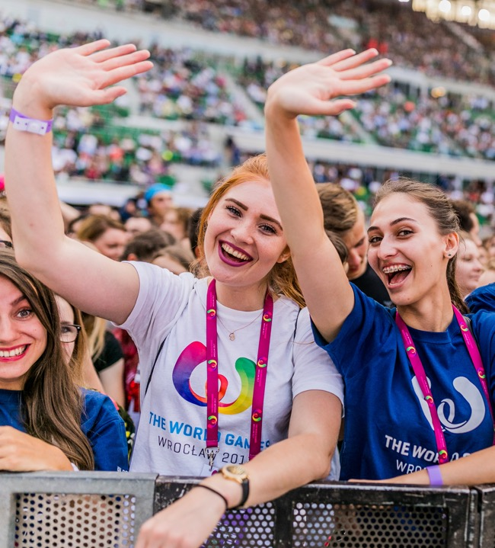

Olympic Partner
The International World Games Association works hand-in-hand with the International Olympic Committee
The World Games 2022 features the best athletes in the world in 34 sport competitions

Slide 4
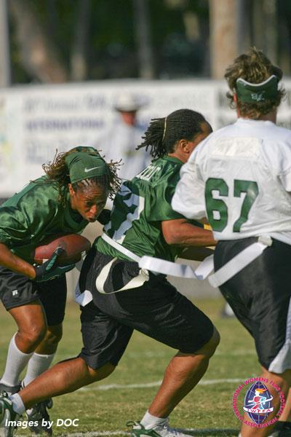

DEDICATED TO INCLUSIVITY
Commitment to Spend 35% with Small, Local and Diverse Businesses
First International Multi-Sport Event to Include an Adapted Sport
Iroquois Nation Recognized For First Time
Empowerment of Women Through Sports

Slide 5


History in the Making
Forecasted attendance: 500,000+
Anticipated economic impact: $256m
Biggest international event in Southeast since ’96 Olympics

Slide 6
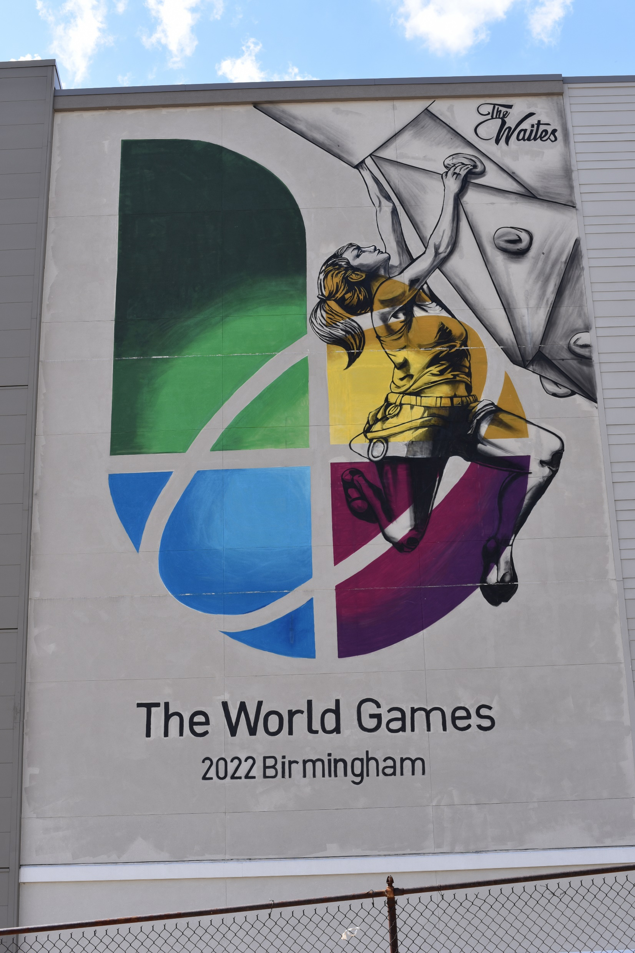
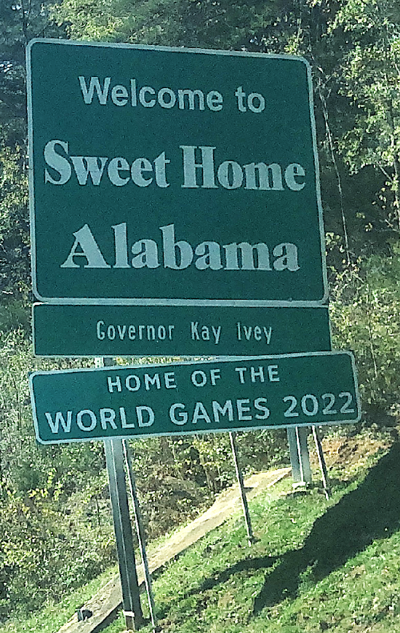
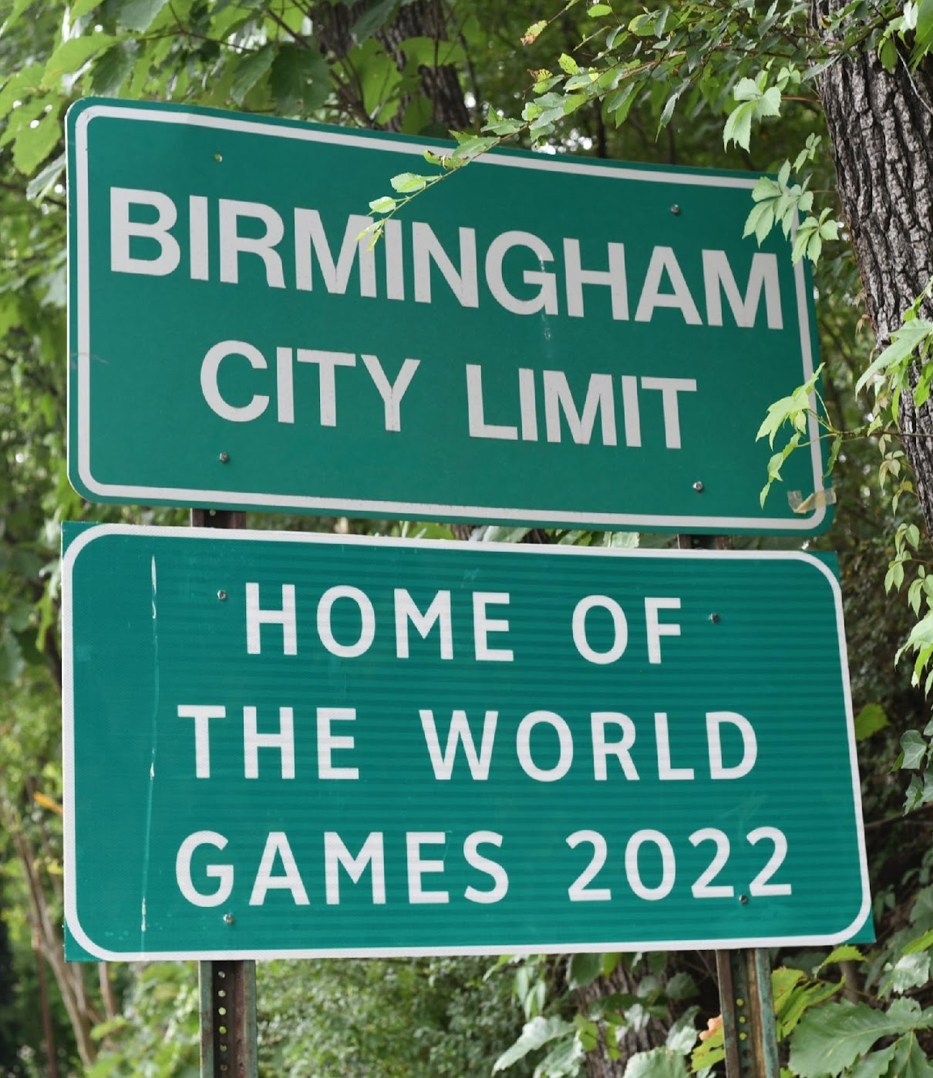
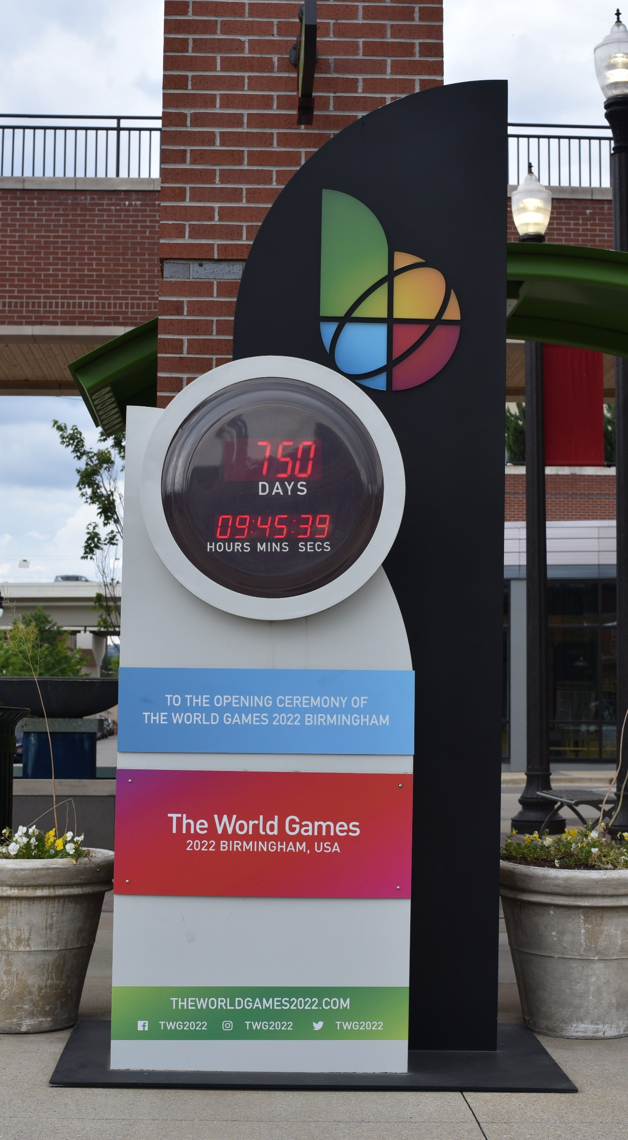
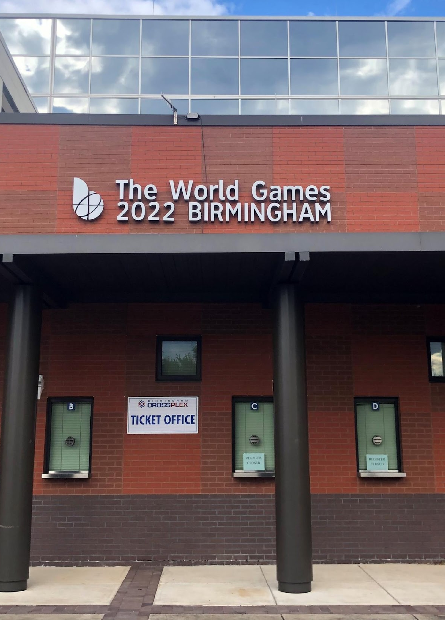
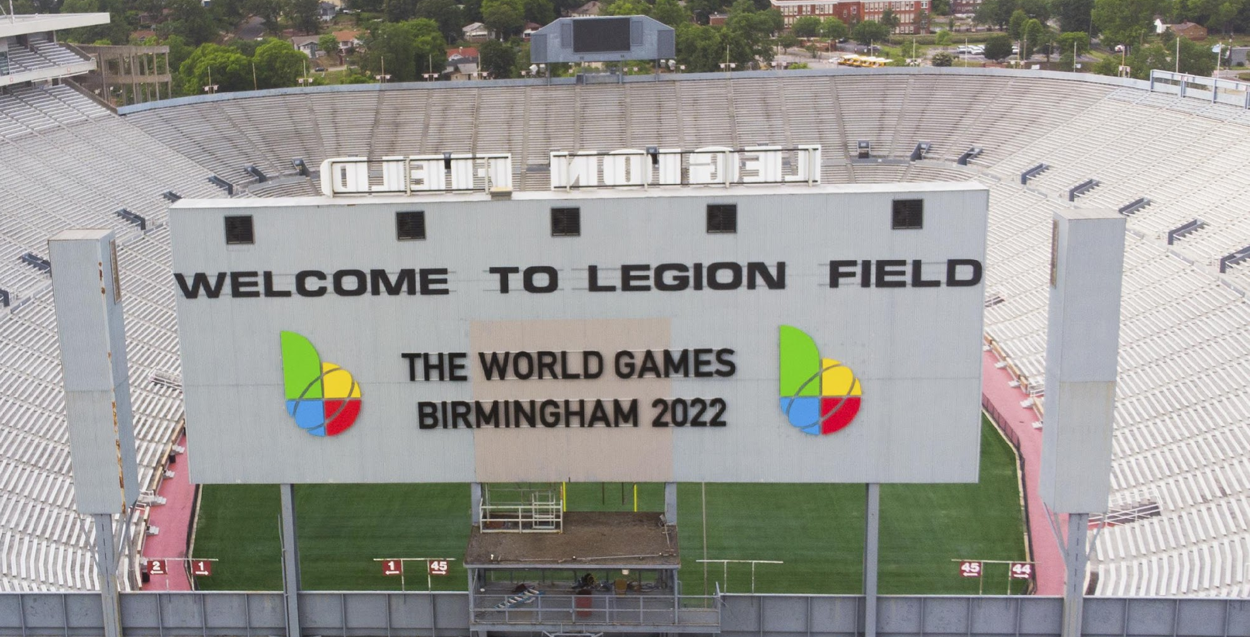
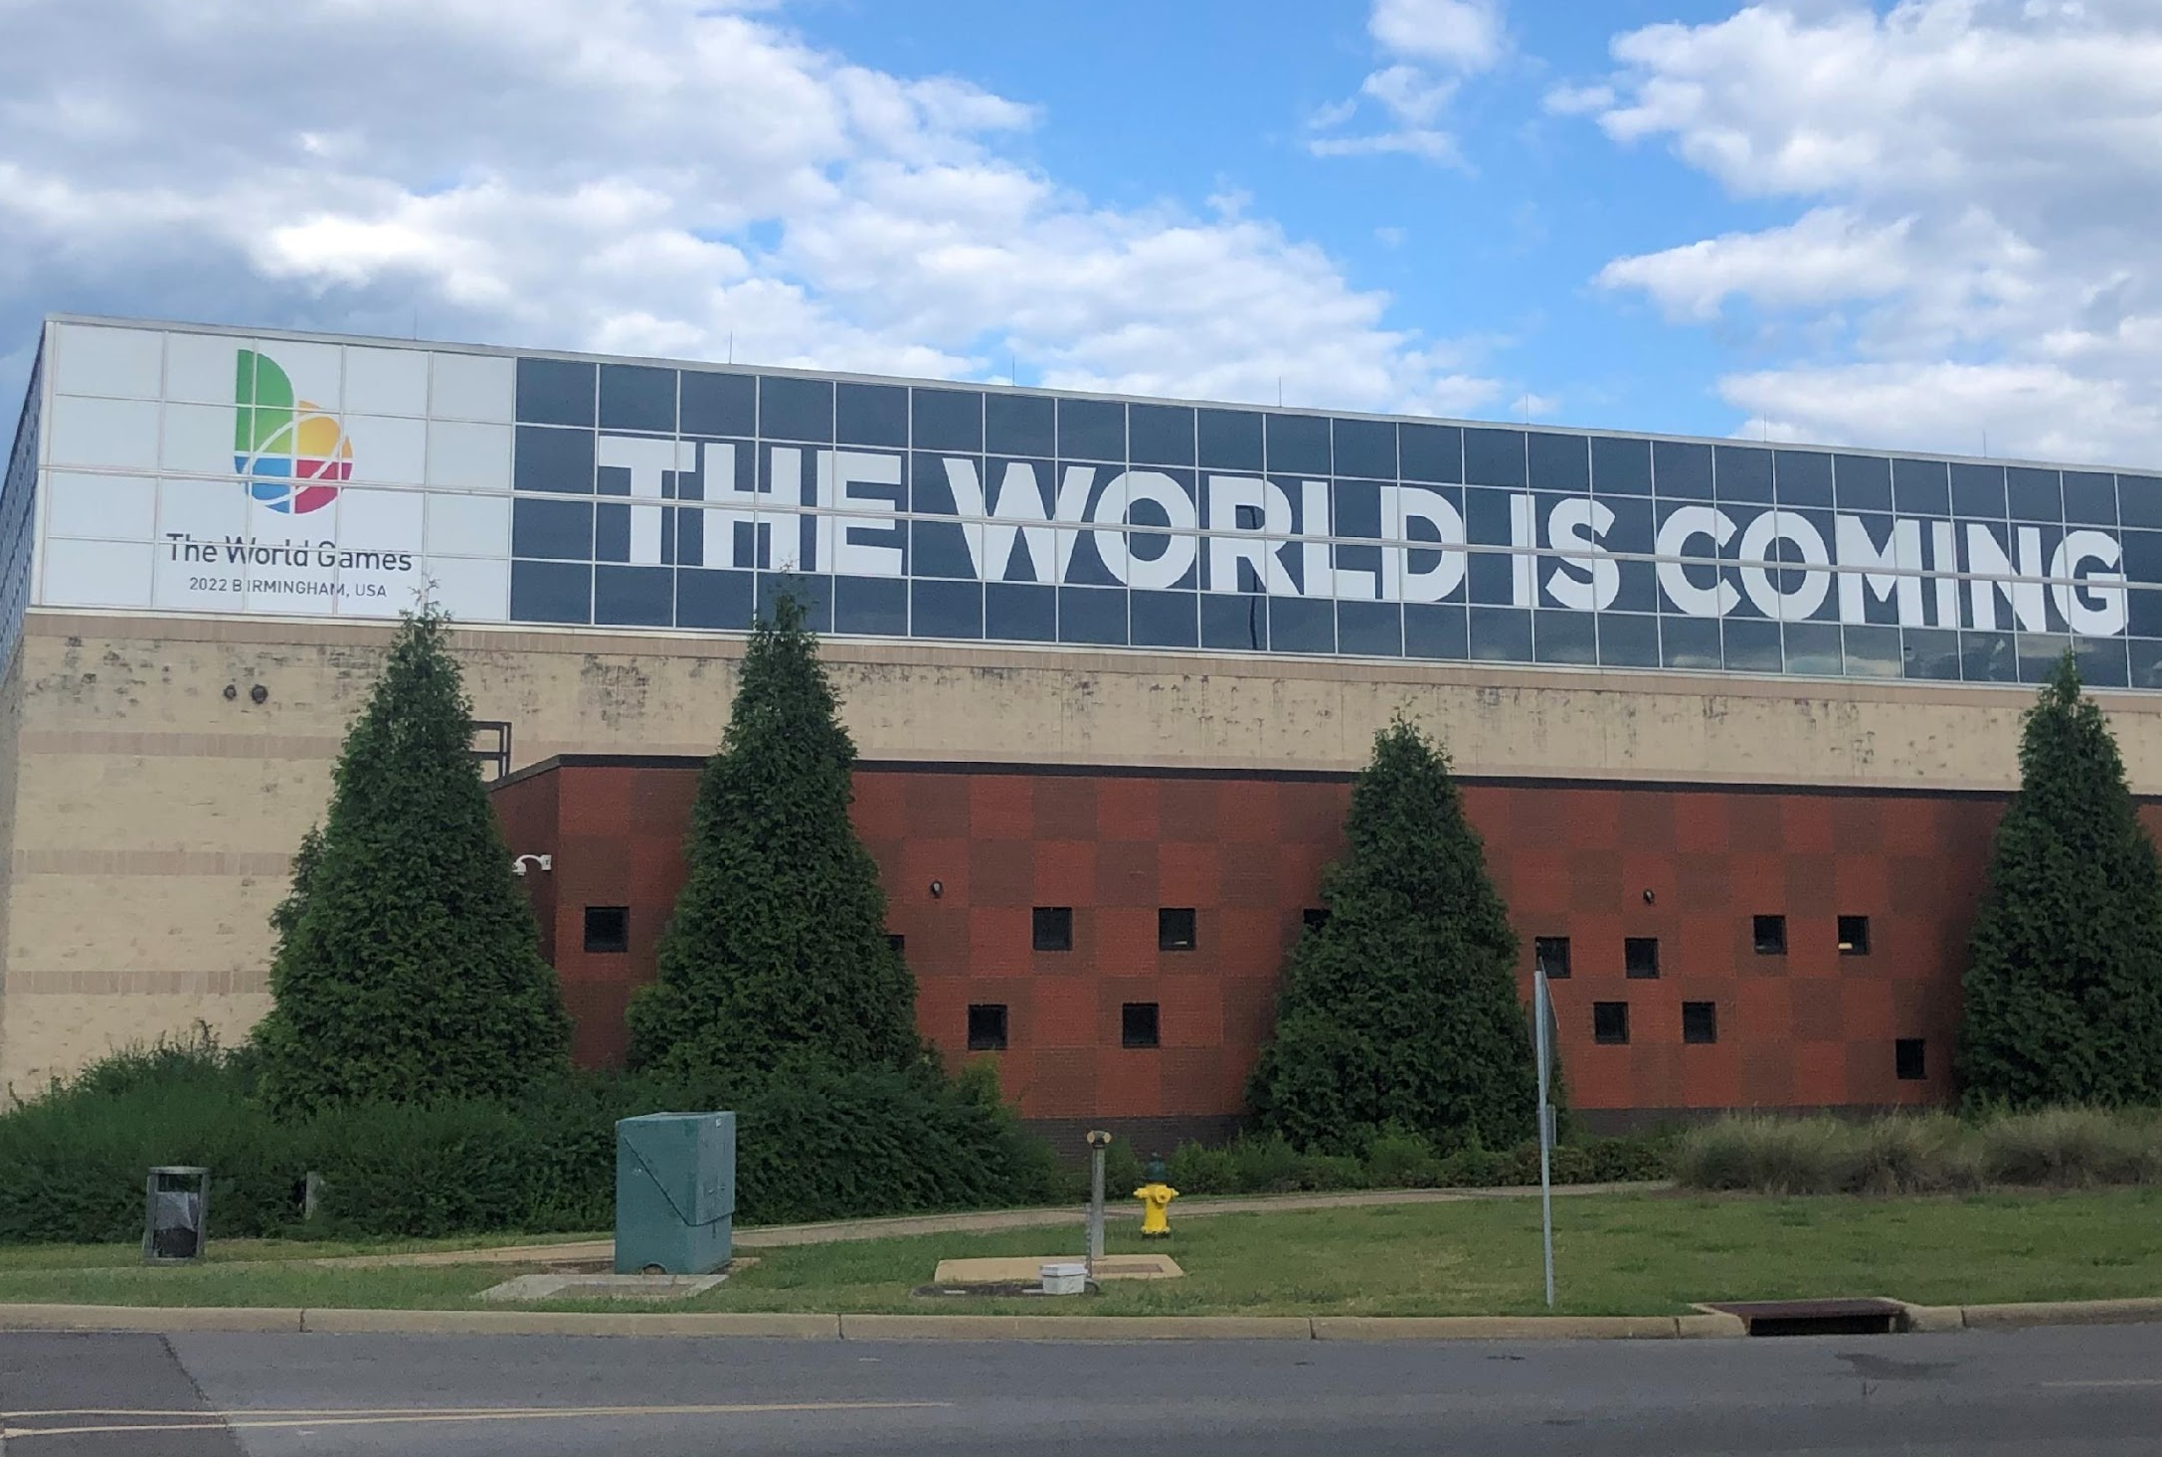
BIRMINGHAM WELCOMES THE WORLD

Slide 7
THE WORLD GAMES 2022
100+ Million Global Audience
July 7
OPENING CEREMONY
Protective Stadium
July 8 - 17
10 DAYS OF COMPETITION
CONCERT SERIES
July 17
CLOSING CEREMONY
Protective Stadium
July 13
ATHLETES’ NIGHT
The World Games Plaza

Slide 8



































WORLD-CLASS COMPETITION
3,600 Elite Athletes | 100+ Countries | Best of the Best
Airsports
Duathlon
Handball
Muaythai
Squash
Archery
Finswimming
Ju-Jitsu
Orienteering
Sumo
Billiards
Fistball
Karate
Powerlifting
Tug of War
Boules Sports
Flag Football
Kickboxing
Racquetball
Waterski & Waterboard
Bowling
Floorball
Korfball
Roller Sports
Wheelchair Rugby
Canoe
Flying Disc
Lacrosse
Softball
Artistic Sports
Ball Sports
Sport Climbing
Strength Sports
Martial Arts
DanceSport
Gymnastics
Life Saving
Trend Sports
Precision Sports
Notes:
Icon ratio is 3:4; the world games 2022

Slide 9
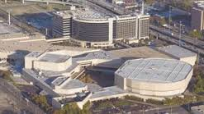
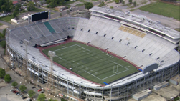
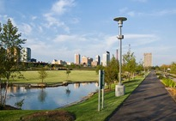
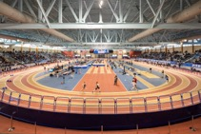
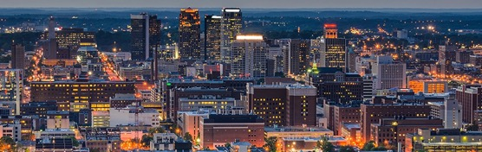


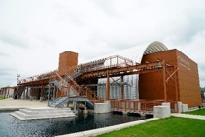
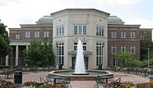
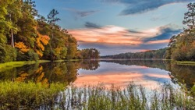
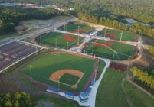
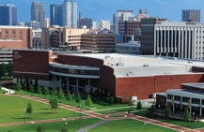
COMPETITION VENUES
Birmingham-Jefferson
Convention Center
Legion Field
Railroad Park
Birmingham Crossplex
Barber Motorsports Park
Sloss Furnaces
Birmingham Southern College
Oak Mountain State Park
Hoover Met Complex
University of Alabama
Birmingham

Slide 10


SPECIAL PRESENTATIONS
TWG 2022 Concert Series
TWG 2022 VIP Gala

Slide 11
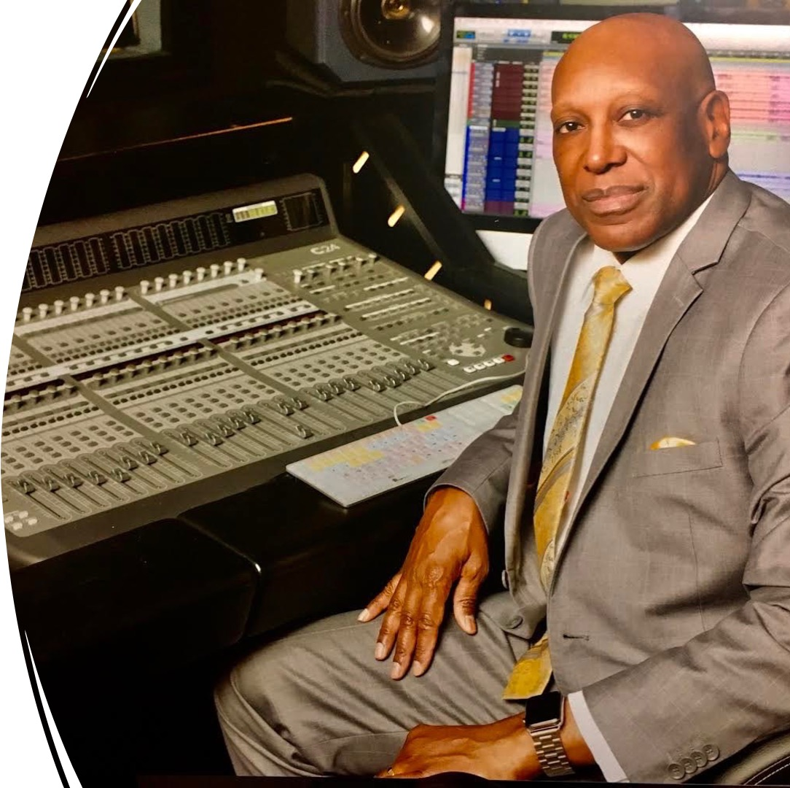
TWG 2022 ARTISTIC DIRECTOR
DR. HENRY PANION

Slide 12





TWG 2022 HONORARY CO-CHAIRS

Slide 13
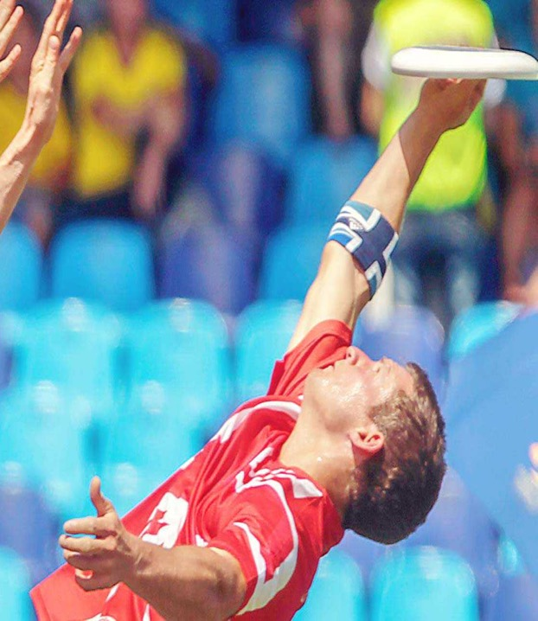



TWG 2022
BROADCAST PARTNERS
Domestic Broadcast Partner
  Ten Hours of Live Coverage
  Two One-Hour Specials
Production and Global Distribution

Slide 14
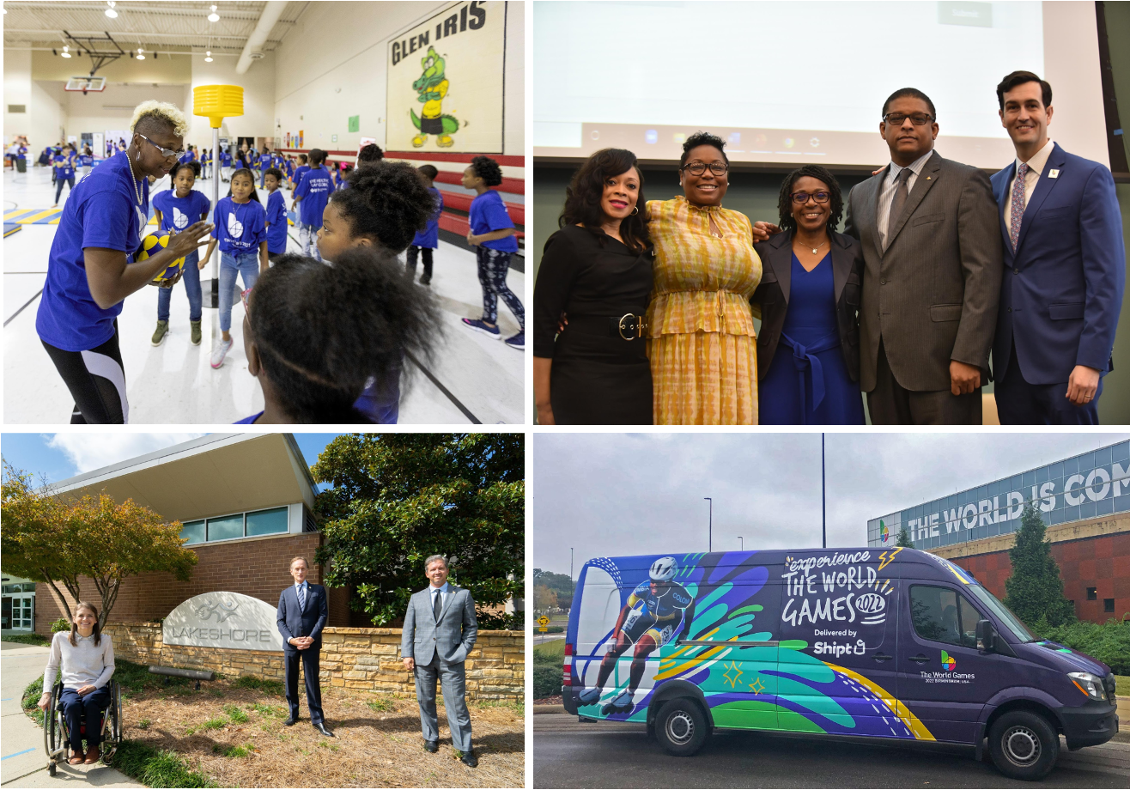





COMMUNITY INITIATIVES

Slide 15



COMMUNITY INITIATIVES
SUSTAINABILITY
Tree planting
Sign Repurposing
Food Harvesting
Zero Waste
Solar Trees
VOLUNTEERS
2500 Volunteers

Slide 16














































Slide 17







JOIN US! TWG 2022!
Notes:
Digital, Social, Outdoor

Slide 18

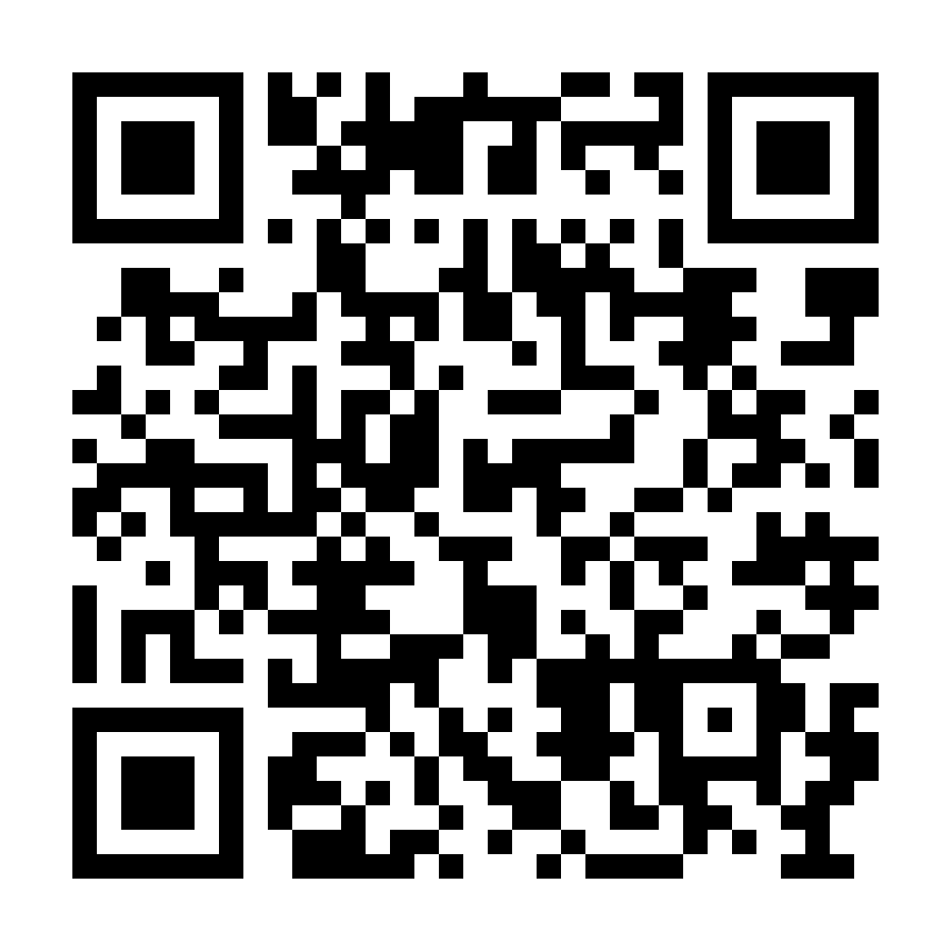

FOLLOW US!
@TWG2022
www.TWG2022.com

